Slide 1
Investment Presentation – For Seed Round Q4 2016

Slide 2
What is booxscale?
The new marketplace aggregator, centralising bookable businesses and surfacing their instant book buttons at the right time, in the right place, within the consumer’s app, mobile and web journeys.
The one-stop shop for revenue integrations of the worlds bookable products and services
The performance based advertising platform for marketplace demand
We are creating a transactional technology layer to support the connecting of marketplace apps and the integrations of our marketplace products and services

Slide 3

Meet the team

Slide 4
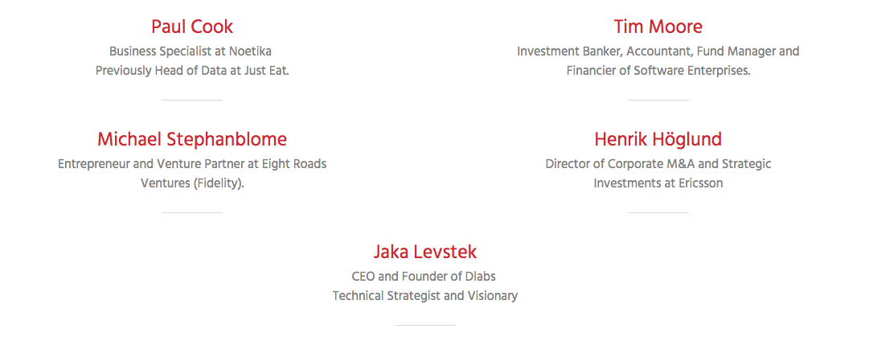
Meet our advisors

Slide 5

We created Booxscale to solve…
Today’s on demand generation want actions and bookable buttons over ads
No aggregator of marketplace supply and ‘bookable’ businesses/buttons
Local and location web experience is dated and not optimised for instant bookings
Shop Now
Book Now
Order Now
Ride Now
Get a Quote

Slide 6
















The solution - The next generation marketplace aggregation platform
1000’s of masseuses
10 of 1000’s of taxis
1000’s
beauty/hair salons
+ vertical / niche marketplaces
110,000+ bookable businesses activated (Demand)
10 of 1000’s of take-aways
g
…
20 Marketplaces integrated
Publishers & directories
Maps & geo apps
Web search & discovery
AI & info
integrations
Chat & social
integrations
Offline and In-home buttons
Booxscale integrations (Supply)
Surfacing buttons to millions of users
…

Slide 7



Value propositions
A performance based advertising platform designed specifically for Marketplaces
Customer acquisition channel for Marketplaces to deliver leads and bookings to their customers and installs of their App
A technology platform built to match a Marketplace’s customers to web directories and Publisher integrations
A one-stop shop for publishers and partners to access multiple Marketplaces
A consolidated reporting dashboard reporting all Marketplace activity and aggregated billing resulting in a single invoice and payment
A technology platform and layer designed specifically to integrate Marketplace buttons and listings into a variety of advertising formats and integrations

Slide 8
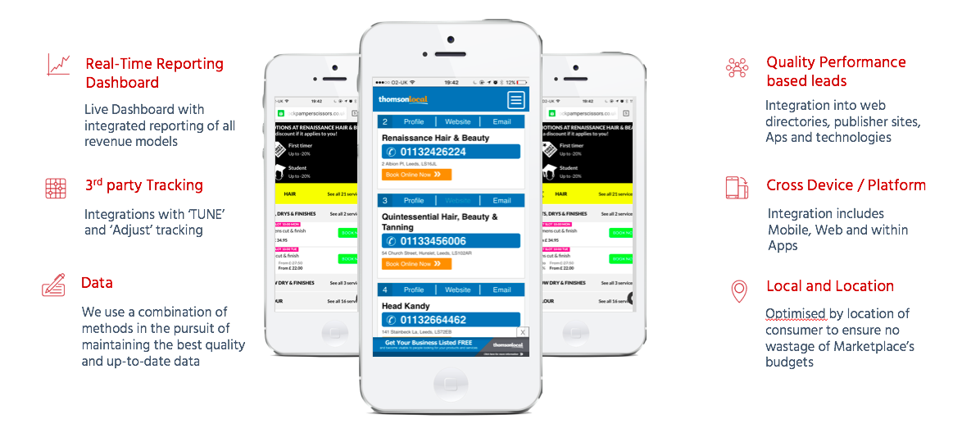

What we do

Slide 9









Vertical niches
Competition in a marketplace vertical creates a higher value for our leads.

Slide 10











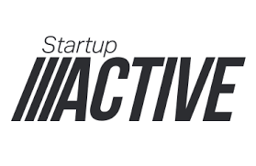



Marketplaces working with us

Slide 11
KPI traction
5x
Increased CVR 5x
better than industry
average
20x
Increased
engagement 20x
better than average
£6-12
Average CPA
between £6 and £12

Slide 12


Our dashboard
Insights in real-time
Search combinations
Location data
Revenue tracking
Advertiser reporting
Inventory reporting
Revenue Models with Marketplaces:
Cost-per-lead (CPL) – Click of Buttons
Cost-per-download/install (CPI) – App install
Cost-per-booking – (CPA) – (Acquisition)

Slide 13




Competitor analysis
Pingup ($5.1m)
Founded 2010, Boston
Multi device/bots/AI
Button ($16.56m+)
Founded 2015, New York
Single App Link Technology
Branch Metrics ($58m)
Founded 2014, Palo Alto
DeepLink Technology
Yext ($119m)
Founded 2006, New York
Digital Location Management
Booxscale - Raising Seed Round in Q4’16 - £750,000 ($975k) with £300k committed to round
Founded 2015 and relaunched in Q3 2016, London
Digital Location Management, Multi Device, Bots, AI, Multi App Link

Slide 14
Projections
Monthly Revenue (£) Growth
Revenue (£)
600k
500k
400k
300k
200k
100k
0k
Businesses
2m
1.5m
1m
0.5
0
Today
Marketplaces (20)
Bookable Business (110,000)
October 2017
Marketplaces (80)
Bookable Businesses (1m)
Revenue (£278k)
a
1 2 3 4 5 6 7 8 9 10 11 12 13 14 15 16 17 18
Months

Slide 15
Summary financials
 | Oct 16 - Dec 16 Q4’16 | Jan 17 - Mar 17 Q1’17 | Apr 17 - Jun 17 Q2’17 | Jul 17 - Sep 17 Q3’17 | Oct 17 - Dec 17 Q4’17 | Jan 18 - Mar 18 Q1’18
Sales | 5,690 | 60,167 | 229,278 | 472,090 | 847,153 | 1,386,318
Total Direct Costs | 2,845 | 30,083 | 114,639 | 236,045 | 423,577 | 693,159
Sales Gross Profit | 2,845 | 30,083 | 123,538 | 305,137 | 657,359 | 1,231,328
Sales Gross Profit % | 50.00% | 50.00% | 51.87% | 56.38% | 60.81% | 63.98%
Total Overheads | 92,283 | 149,250 | 217,400 | 175,650 | 196,400 | 195,450
EBITDA | (89,439) | (231,667) | (318,862) | (208,013) | 10,959 | 585,878

Slide 16
Investment summary to date
Q4’16 Seed Investment round summary
First investment of £120,000 received in 2015 – used to stress test the market, model and build a beta platform
Closed an additional ‘friends and family’ SEIS round in Aug 2016
Re-branded and re-launched Booxscale in Sep 2016
Solid traction and momentum both continue to grow with first month’s revenue reporting occurring in Nov 2016
Booxscale is raising £750,000 in Q4 2016
We have two investors who will invest £150k each and who both would like to follow in the round
We are seeking a strategic lead investor as well as Angel or Institutional investors to participate in this round
We have EIS qualified stock available as part of this round
Our valuation is £2.25m pre-money

Slide 17
Contact to discuss Investment
Max Moore
Co-founder and CEO
+44 (0) 7788 562 067
max@booxscale.com
Jozef Wallis
Co-founder and COO
+44 (0) 7885 477 169
jo@booxscale.com

